Slide 1
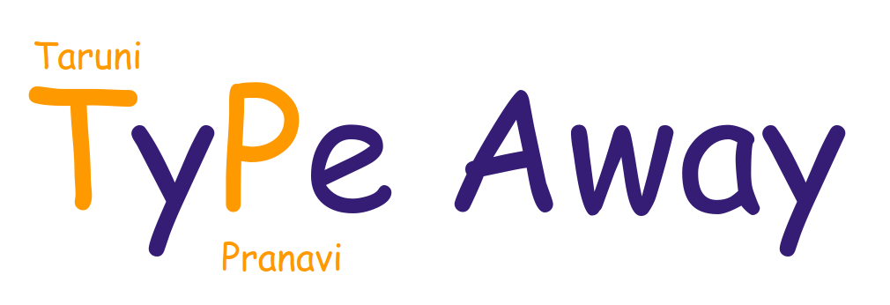

Slide 2
ABSTRACT
Type Away, as the name suggests, is the recreation of a linux text editor, made using C language. It has exciting features like search, syntax highlighting and adding notes to your text file. The UI is very simple and the colours used catch the eye immediately. This editor allows the user to open, read and edit new and existing documents. The user can also search through the documents. We have also included an additional feature to write notes in a text file.

Slide 3
PROJECT STAGES
STEP 3
STEP 1
STEP 2
Save the changes.
Open the desired document
Make changes to the document.

Slide 4
Features
Incremental Search
Syntax highlighting
Notes
The users can search for a word or sequence of characters in the file that has been opened.
The keywords, single line comments and the multiline comments in a C file are highlighted.
In case of a text file, the user can take notes by typing “note:” which would be highlighted.

Slide 5
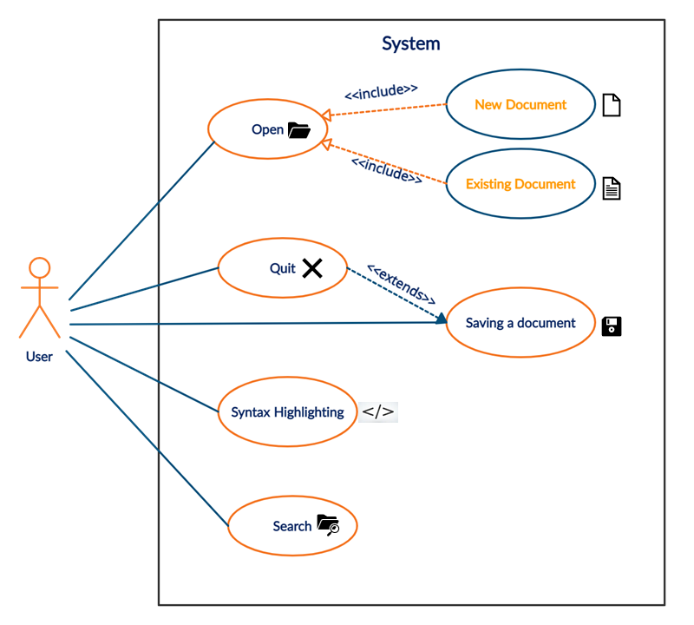

Slide 6
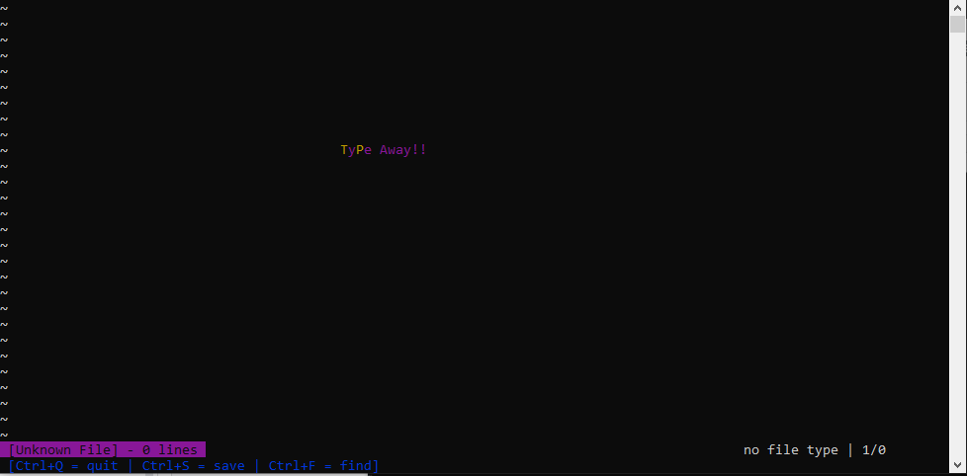
First screen when opening a new document

Slide 7
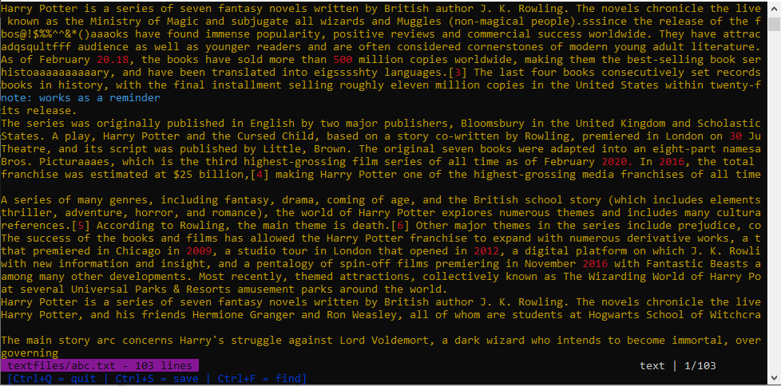
First screen when opening an existing document

Slide 8
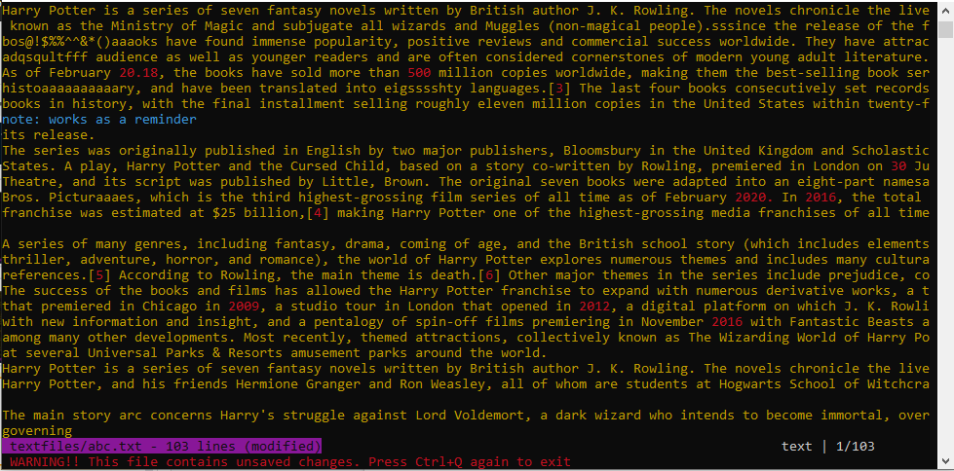
When we try to quit before saving, it gives a warning
Notes feature

Slide 9
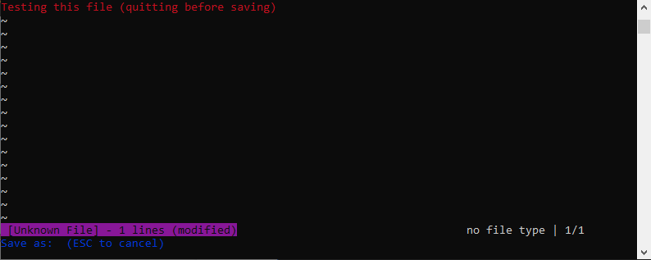
Save as (In a new document)

Slide 10
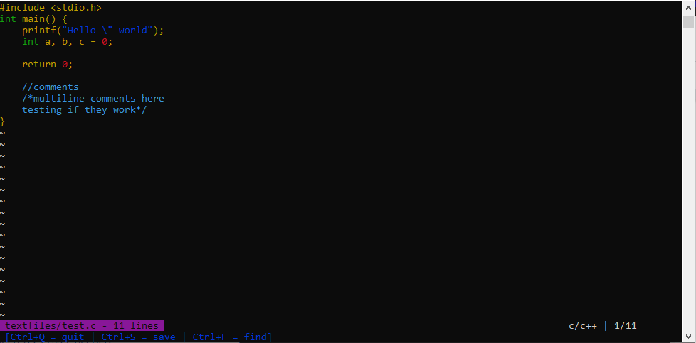
Syntax Highlighting for a C file

Slide 11
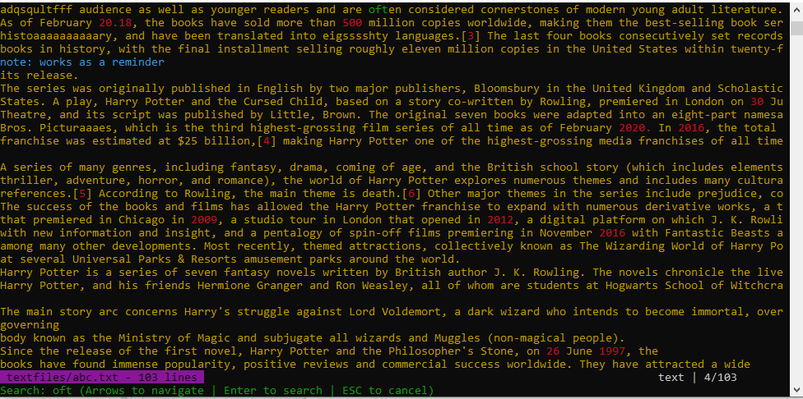
Search Feature

Slide 12
FUTURE SCOPE
AUTO INDENTATION
MORE FILE TYPES
COPY PASTE OPTION

Slide 13
RESOURCES
https://devdocs.io/c/
https://viewsourcecode.org/snaptoken/kilo/
https://stackoverflow.com/
https://www.geeksforgeeks.org/
https://docs.microsoft.com/en-us/windows-server/administration/windows-commands/color
https://bluesock.org/~willkg/dev/ansi.html
https://vt100.net/docs/vt100-ug/chapter3.html

